Slide 1


On-Shelf Availability Detection using YOLOv7
Prajna Dutt M D
R 2 0 E K 0 2 3
Project Guide
Prof Nandini
D a t e : 08 / 0 5 / 2 3

Slide 2
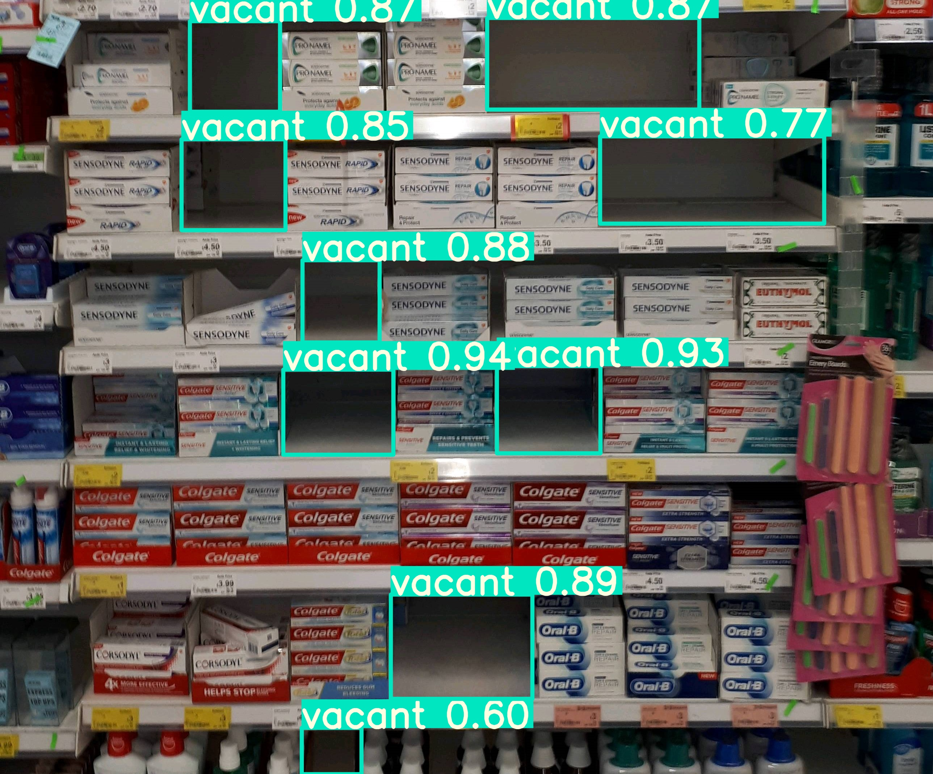
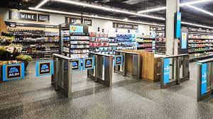
AGENDA
Introduction
Objective
Background and Related Works
Materials and Methods
Preparation of Dataset
Model Training
Performance Evaluation
Conclusion and Future Works
2

Slide 3
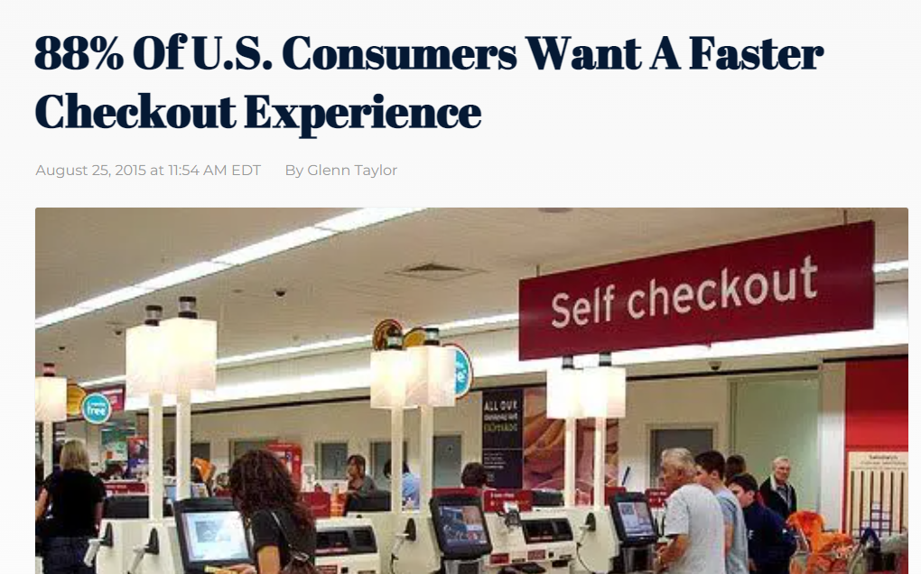
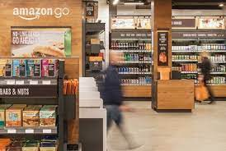
Introduction
The retail sector - significant transition to improve customers' shopping experiences and to make services as seamless as possible
Optical Detection: -restocking methodology
-item interaction
-consumer movement
-gesture detection
-product recognition on shelves.

Slide 4
Objective
On-shelf availability (OSA) is the most significant factor of seamless checkout stores.
The consumer can't find the item or its out of stock
they won't be interested in going back and will instead choose another store.
This has an effect on the current sales and future demand of the stores

Slide 5
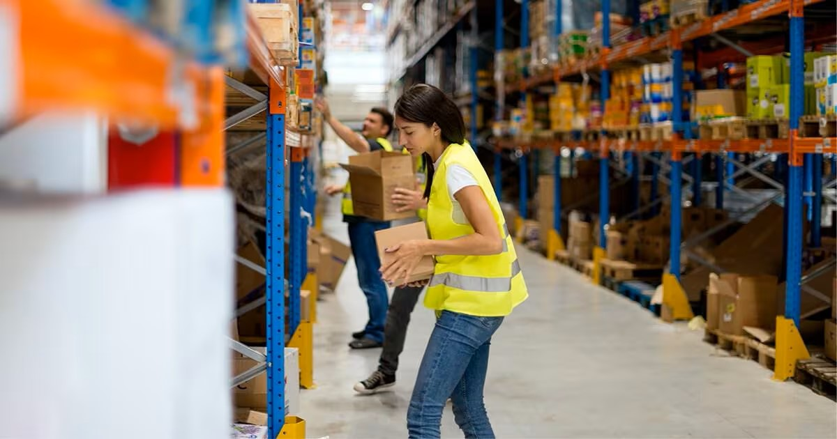
Background Works
Manual audits and supervision
RFID (Radio-Frequency Identification technology)
Use of weight-sensors.
Supervised machine learning by employing Support Vector Machines.
Deep Learning Algorithms - Faster R-CNN, Cascade RCNN.
SURF & SIFT Approach.
YOLOv4, YOLOv5

Slide 6
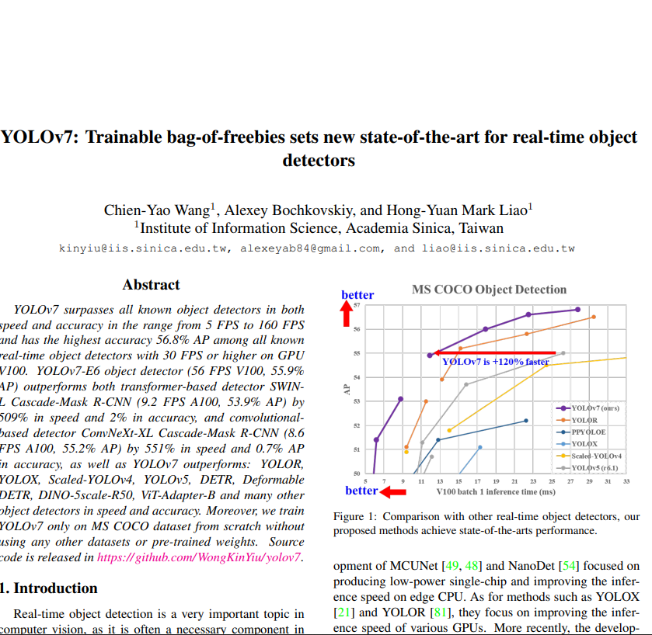
Materials and Methods
YOLO "You Only Look Once” : The entire image's prediction is carried out by the algorithm
in a single run,
speeds up performance.
uses fewer resources
in turn minimizes the cost
precision and quickness

Slide 7
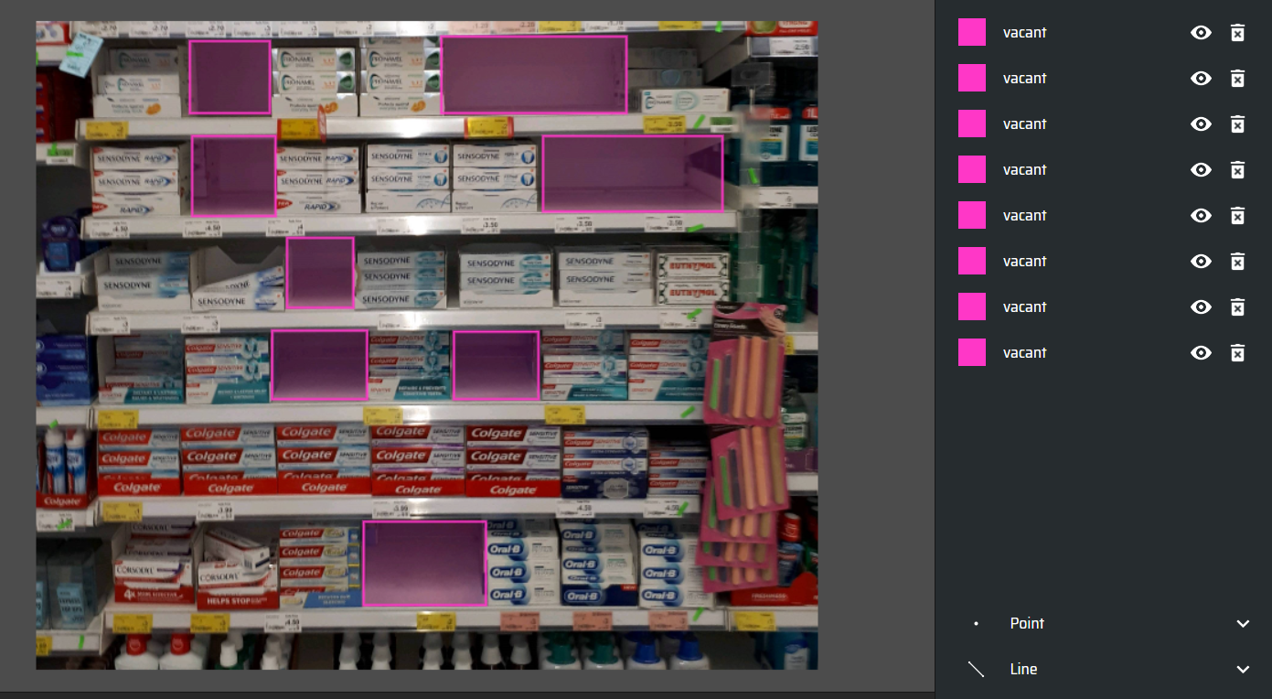
Preparation of Dataset
SKU-110k annotated dataset, which consists of 11,762 densely packed shelf photos that were captured in a normal retail environment.
Extracted 500 images, 80% training set & 20% validation set.

Slide 8
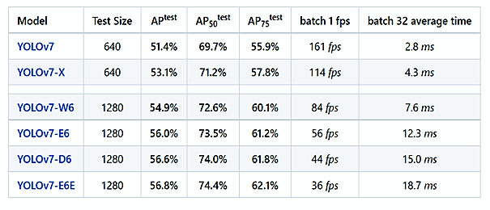
Model Training
matplotlib>=3.2.2
numpy>=1.18.5
opencv-python>=4.1.1
Pillow>=7.1.2
PyYAML>=5.3.1
requests>=2.23.0
scipy>=1.4.1
torch>=1.7.0,!=1.12.0
torchvision>=0.8.1,!=0.13.0
tqdm>=4.41.0
protobuf<4.21.3
RTX A6000 – 48GB VRAM
NVIDIA Quadro P2000 with 4 GB RAM on a local machine.
Google Colab: NVIDIA K80 GPU and 12 GB of RAM.

Slide 9
Performace Evalution
!python train.py --device 0 --batch-size 8 --epochs 100 --img 640 --data data/custom_data.yaml --hyp data/hyp.scratch.custom.yaml
--cfg cfg/training/yolov7_custom.yaml --weights yolov7.pt --name yolo7x-custom
9
Pre-trained Model weights | Batch Size | Image Size | Number of Epochs: Mean Average Precision
epochs |  |  |  | 100 | 300 | 600 | 900
YOLOv7 | 4 | 640 |  | 0.91 | 0.92 | 0.93 | 0.87

Slide 10
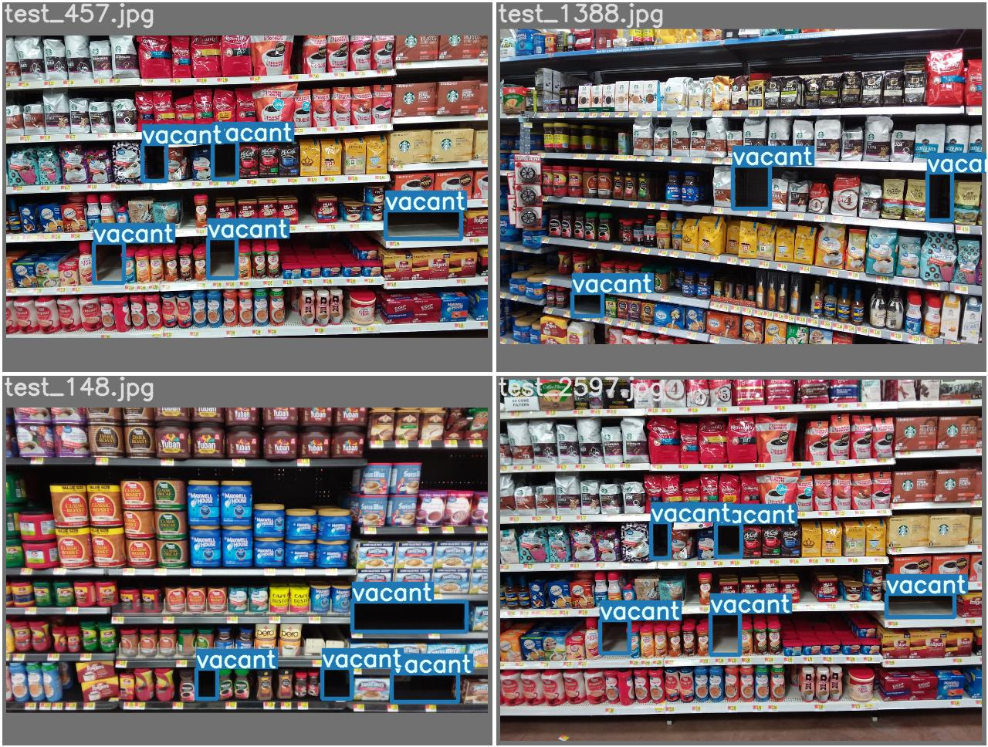

Slide 11
CONCLUSION & FUTURE WORKS
Investigation using semi-supervised or unsupervised learning techniques.
Solution to avoid manual annotation process.
Other components of the system can be considered for future development. Say, the placement of the camera and other input devices, customer hand gesture and posture detection, product placement and identification, and the design of the mobile application

Slide 12
THANK YOU

